Slide 1



RI Drought Steering Committee
NWS Update
Tuesday October 18th 2022
Prepared by: National Weather Service Boston/Norton, MA
NWSBoston
www.weather.gov/box

Slide 2
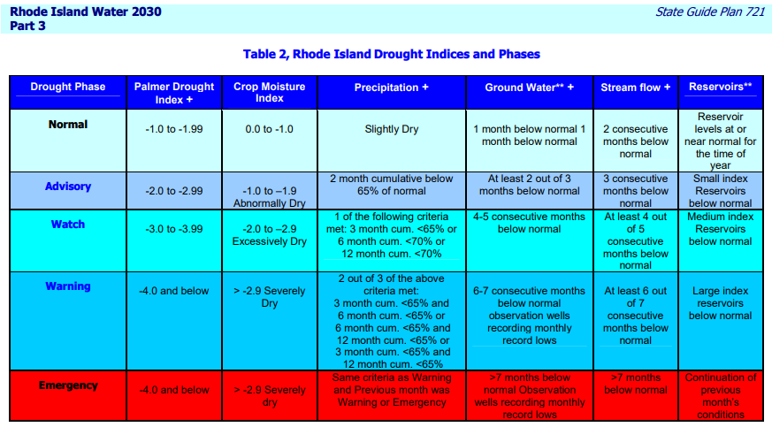
Drought Indices from RI Water 2030

Slide 3
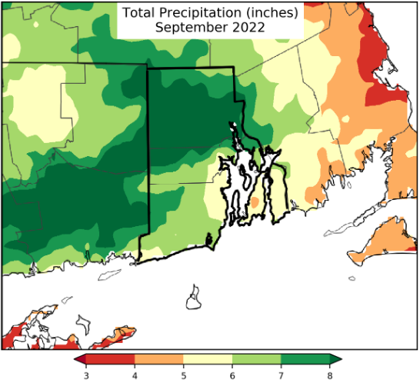
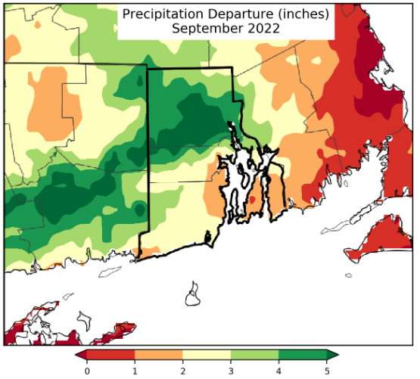
September 2022 Rainfall and Departure
Generally, 5 to 8 inches across RI with isolated higher and lower amounts

Slide 4
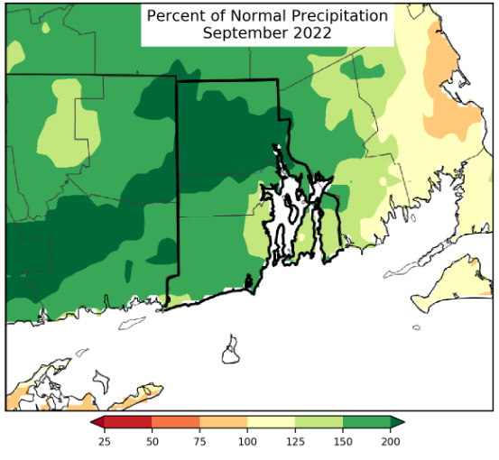
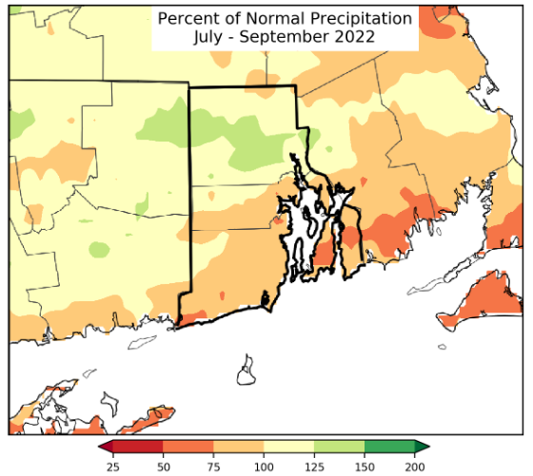
August and June-August Percent of Normal

Slide 5
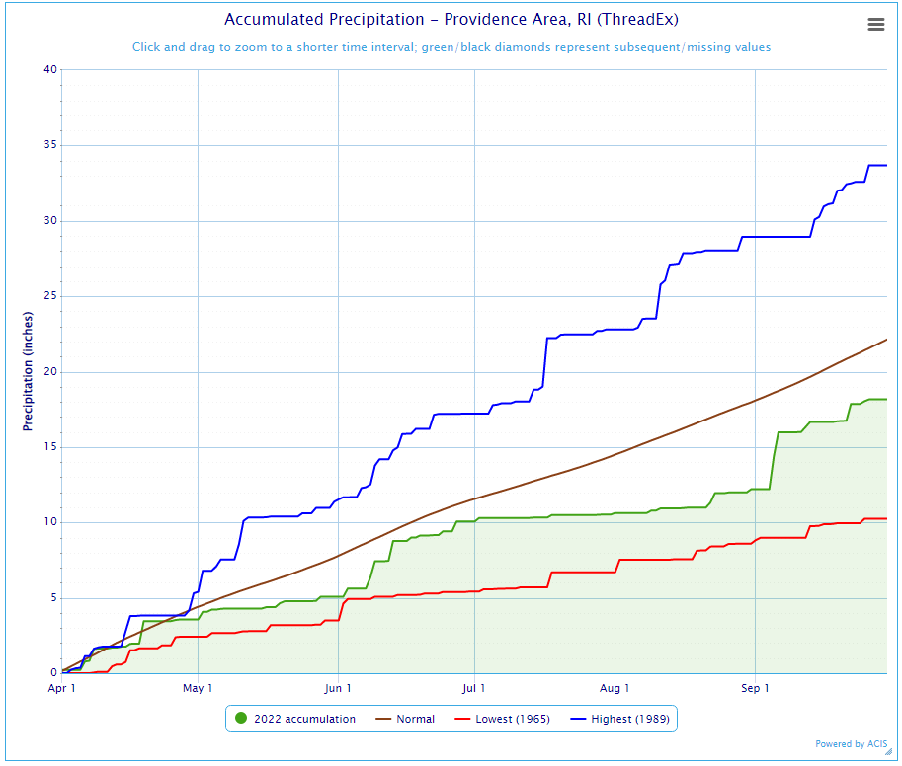
Rainfall Profile: Providence
End of September: Deficit since April 1st
Fell from 5.9 inches to 3.98 inches
Green line shows 2022 Rainfall accumulation
Brown line shows “normal” rainfall
Blue and Red Lines show highest and
lowest rainfall years respectively

Slide 6
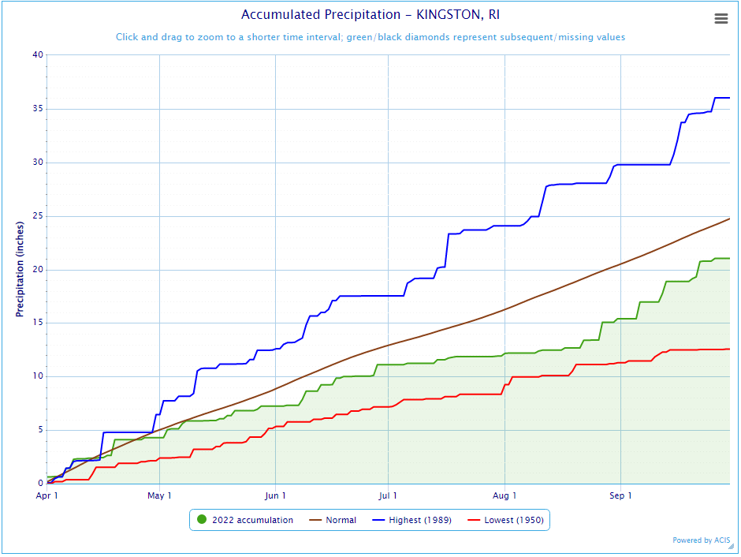
Rainfall Profile: Kingston
Much appreciation to the Kingston RI Cooperative Weather Observers!
End of September: Deficit fell from 5.13 inches
To 3.55 inches since April 1st
Green line shows 2022 Rainfall accumulation
Brown line shows “normal” rainfall
Blue and Red Lines show highest and
lowest rainfall years respectively

Slide 7
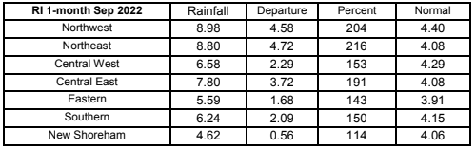
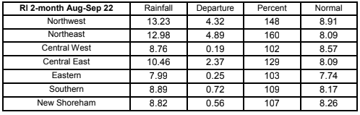
September and Aug/Sep Rainfall by Region
1-month and 2-month cumulative rainfall was near or above normal for all regions

Slide 8
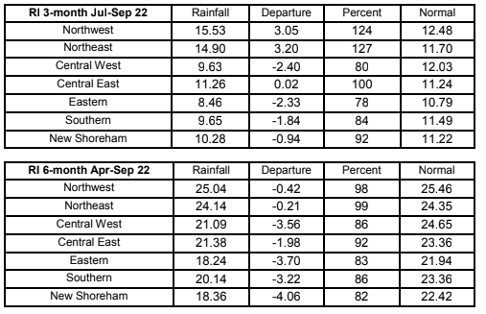
3 and 6-Month Rainfall by Region
Northern and Central East Regions at or above normal
Central West, Eastern, Southern, and New Shoreham below normal, but not meeting drought advisory criteria
6 Month Rainfall now slightly below normal across the state.
Precipitation Deficits no longer meeting Drought Advisory Criteria

Slide 9
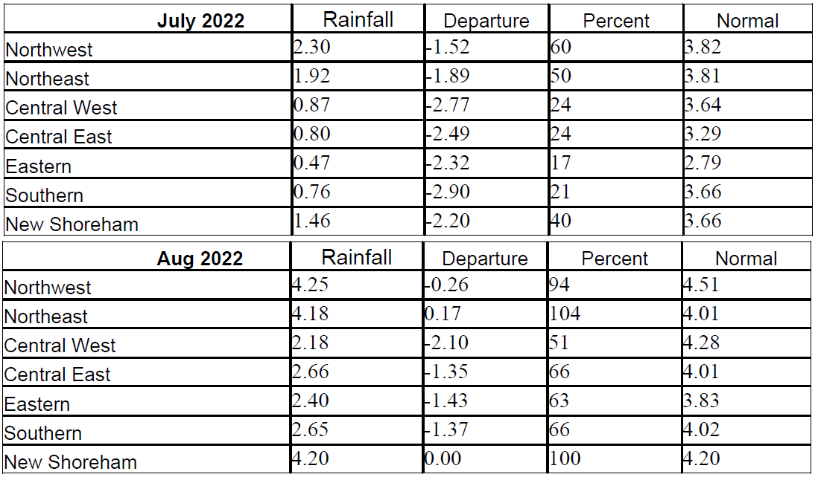
Jul and Aug Rainfall by Region
Recovery requires 3 months of normal precipitation
July all regions were below normal
August 5/7 regions recovered to normal

Slide 10
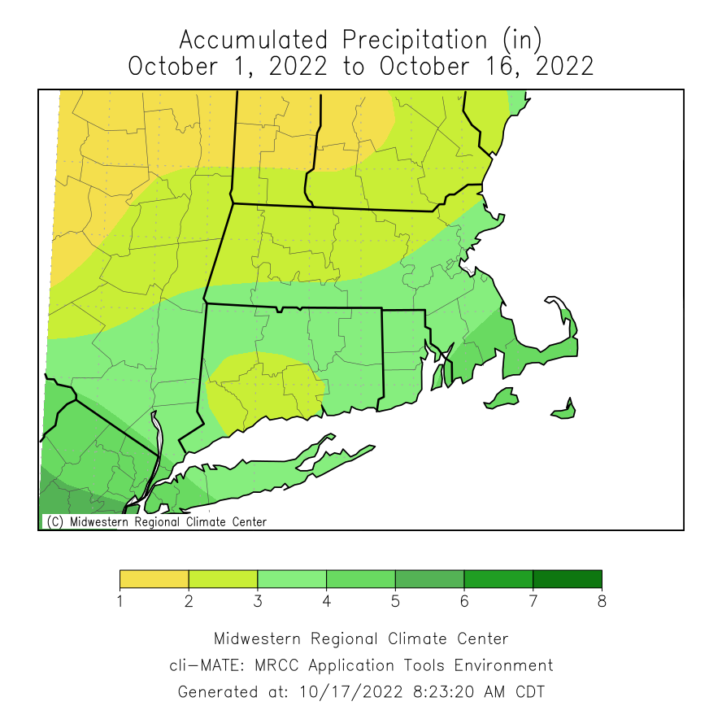
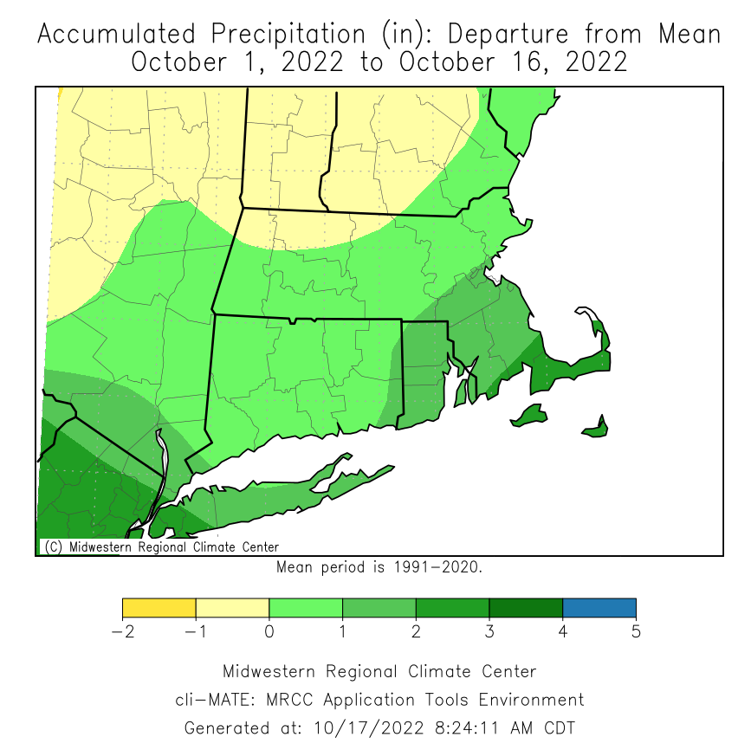
October MTD Rainfall
State of Rhode Island is 1 to 2 inches above normal so far this month (as of October 16th)

Slide 11
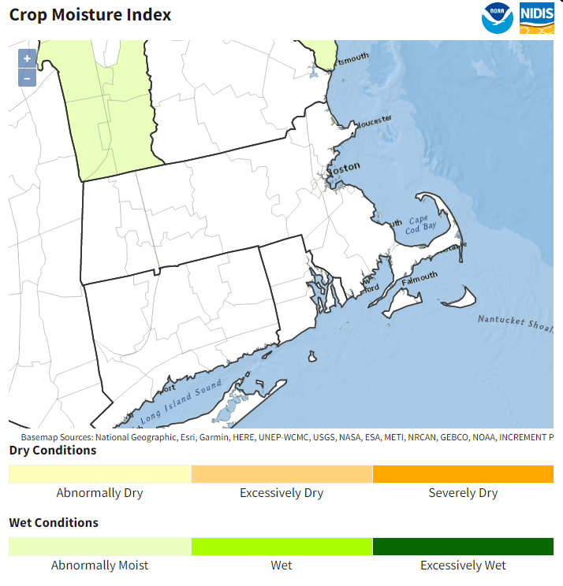
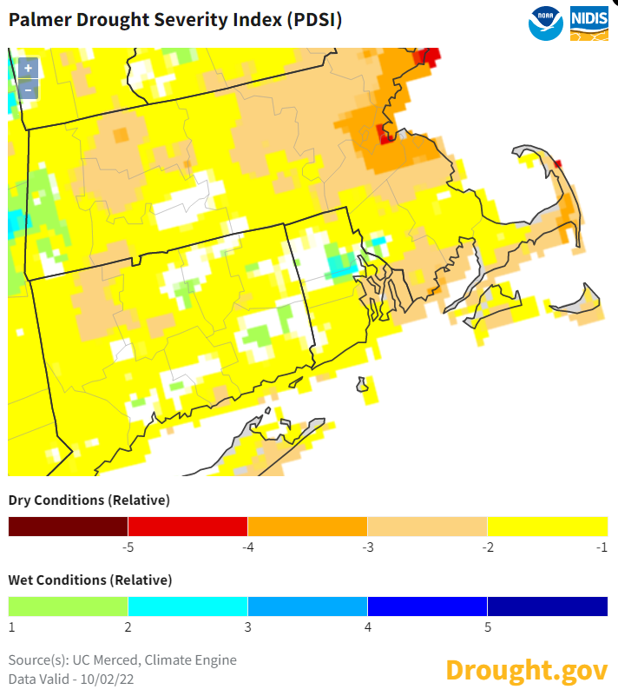
CMI and PDSI
Crop Moisture Index and Palmer Drought Severity Index
Gridded PDSI > -2 across the region (experimental)
Regional value from CPC as of 10/8/22: -0.07
No longer meets drought criteria
CMI Index is Normal (valid 10/08/22)

Slide 12
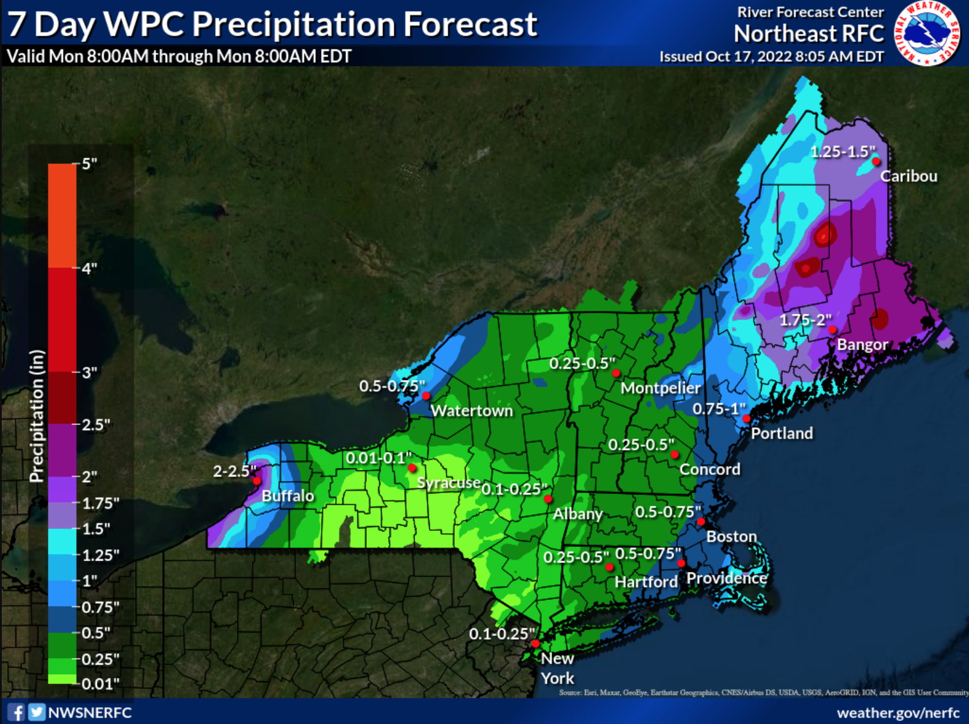
Forecast Through 8 am Monday 10/24
No substantial rainfall forecast beyond Tuesday
0.5 to 0.75 inches of new rainfall Monday - Tuesday
Trending cooler and drier Wednesday through Friday
Warm trend settles in this weekend and carries into early next week

Slide 13
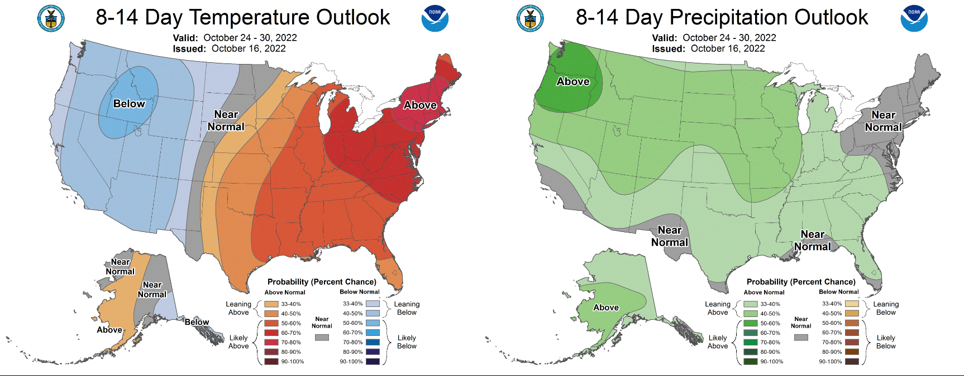
CPC 8-14 Day Outlook
October 24-30 2022

Slide 14
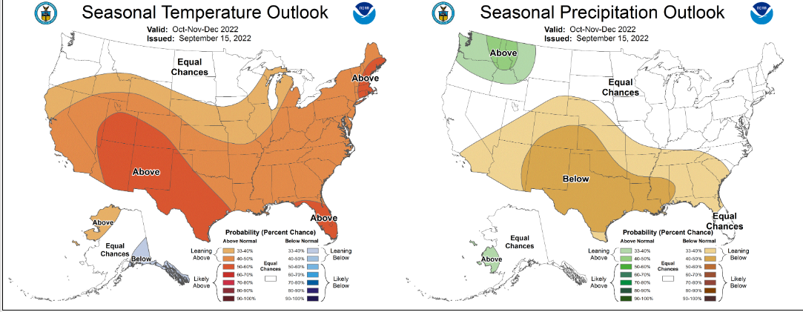
CPC Outlook for Sep/Oct/Nov

